Slide 1
Live Session: Unit 3
May 25, 2015

Slide 2
Hypothesis Testing
Six Steps:
Identify the hypotheses.
Draw a normal curve, and find and label the critical values.
Find and label the test statistic.
Find the p-value.
Make a decision (either reject or fail to reject the null hypothesis).
Write your conclusion (in the context of the problem, with correct units, and minimal use of statistical terms).

Slide 3
Hypothesis Testing
Step One: Identify the hypotheses.
H₀: μ = 0
H₁: μ > 0
Or
H₀: μ ≤ 0
H₁: μ > 0

Slide 4
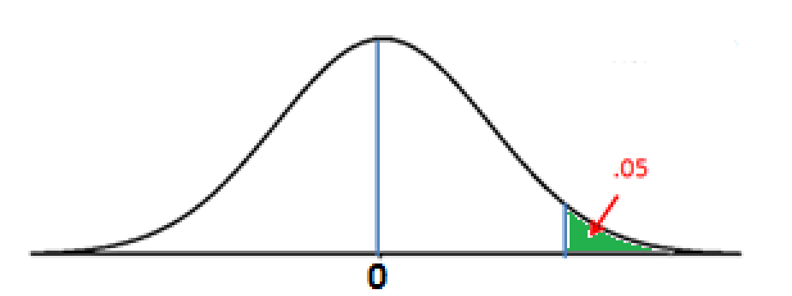
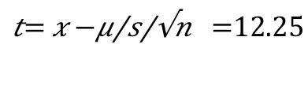
Hypothesis Testing
Step Two: Draw a normal curve, and find and label the critical values.
Step Three: Find and label the test statistic.
1.753
12.75
$$t= \frac{\overline{x}−μ}{\frac{s}{\sqrt{n}}}=12.25$$

Slide 5
Hypothesis Testing
Step Four: Find the p-value.
p <0.001, according to SAS
Step Five: Make a decision.
Since p is less than 0.05 (the significance level), we reject the null hypothesis.
Step Six: Write a conclusion.
There is statistically significant evidence showing that the mean is greater than zero.

Slide 6
Cloud Seeding Study
Type the detail of the experiment that exemplifies each term below. The first one is done for you.
Randomization: The decision to load the plane with silver oxide was made using a random mechanism.
Placebo effect: The same procedures were followed, regardless of whether or not the clouds were seeded. (The plane flew through the clouds whether or not silver oxide was loaded).
Blinding: The pilot and the experimenter did not know if the clouds had been seeded.

Slide 7
Cloud Seeding Study
Are the original cloud-seeding data normally distributed with equal variance? Explain.
No. The box plots (on page 60 before the log transformation is applied) are heavily skewed and the boxes are quite different in size, depicting a much larger spread in the seeded data.
Does a logarithmic transformation help? Explain.
Yes. The logarithmic output does a good job of correcting a lot of the bad behavior. The boxes are more symmetric (spread is now similar) on page 60, the means are more centered in the boxes and there appears to be fewer outliers. Skewness has been "fixed" and this is evident by the central position of the boxes within the whiskers.

Slide 8
Agent Orange Study
What is the effect of taking a random sample of the non-Vietnam veterans for comparison with the Vietnam veterans?
Note that the text states that neither sample (646 veterans who served in Vietnam, and 97 veterans who served at the same time as the Vietnam veterans in the US or Germany) were random. However, the researchers took a random sample of 97 out of the 646 so that sample sizes were comparable. Once we take a random sample, we run the risk of obtaining an extreme result (either very unhealthy individuals or very healthy individuals) by chance alone.

Slide 9
Agent Orange Study
Can we make cause-and-effect conclusions from this study? Explain.
This study is observational in nature, so we are unable to infer causality. Note that having random samples of veterans is not the same as randomly assigning veterans to a “treatment.” Also note that this study was done twenty years after the Vietnam War– there is absolutely no way to have randomly assigned the veterans to a treatment.

